Slide 1
COM-I ( Introduction to Business)
Dr. Sumita Shankar

Slide 2
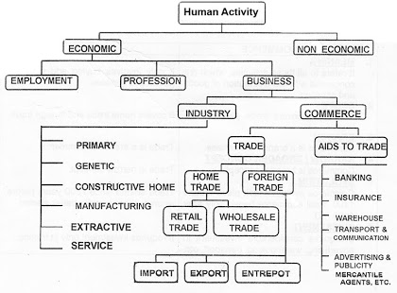

Slide 3

EXONOMIC AND NON ECONOMIC ACTIVITY

Slide 4

EMPLOYMENT

Slide 5

PROFESSION

Slide 6

BUSINESS

Slide 7

INDUSTRY

Slide 8
COMMERCE

Slide 10


